Slide 1
ACHIEVEMENTS AND AWARDS 2022-2023
OPTIMIST INTERNATIONAL CARIBBEAN DISTRICT

Slide 2
OPTIMIST INTERNATIONAL CARIBBEAN DISTRICT
QUARTERLY RECOGNITIONS

Slide 3
Club Travel Award
Incentive: Trophy and complimentary registration to the next
District meeting for one member of the club.
To be awarded to:
The club with the highest percentage of membership registered before the first day of the District’s Conference/Convention.

Slide 4
Zone Travel Award
Incentive: Trophy
To be awarded to:
The zone with the highest percentage of its membership registered before the first day of the District’s Conference/Convention.

Slide 5
Recruiter of the Quarter Award
Incentive: Trophy
To be awarded to:
The member who recruits the most new-members for each quarter.

Slide 6
Club of the Quarter Award
Incentive: Banner Patch
To be awarded to the club that:
Has the highest percentage growth and retention of membership for the quarter
Organizes and executes at least three (3) projects including the District’s flagship project
Is represented at the District meeting for the quarter for which the award relates and
Is in good standing with Optimist International and the District (dues fully paid up within 15 days of the quarter ending).
How to Apply:
Submit application within 15 days of the quarter ending using the Google link provided.

Slide 7
Zone of the Quarter Award
Incentive: Trophy
Eligibility:
Awarded to the Zone that:
Has the highest percentage growth and retention of membership for the quarter
Organizes and executes at least five (5) multi-club or zone projects including the District’s flagship project
Has the most clubs in good financial standing with the District.
How to Apply:
Submit application within 15 days of the quarter ending using the Google link provided.

Slide 8
OPTIMIST INTERNATIONAL CARIBBEAN DISTRICT
ANNUAL RECOGNITIONS

Slide 9
Award for Membership Growth and Retention
Incentive: Plaque
Eligibility:
This award is presented to the Club:
With the highest percentage growth and retention of membership for the Optimist Year 2022-2023
Is in good standing with Optimist International and the District (dues fully paid up within 15 days of the quarter ending).

Slide 10
Most Outstanding JOI Club Award
Incentive: Plaque
Eligibility:
Awarded to the most outstanding JOI Club which:
Meets its financial obligations to Optimist International
Has the highest percentage growth and retention for the Optimist Year 2022-2023
Participates in at least one joint club meeting/project with another JOI club or an adult club
Organizes and executes at least three (3) projects including the District’s flagship project.

Slide 11
Community Project of the Year Award
Incentive: Banner Patch
Eligibility:
To be awarded to the club:
Whose project has :
The greatest reach in the community (assessment based on the number of persons benefitting)
Greatest media exposure to Optimism.
Copies of all articles (or links thereto) related to the project and/or recordings of any media interviews (or links thereto) must be included with the application form.
How to Apply:
Submit application by October 15, 2023 using the Google link provided.

Slide 12
Club Foundation Representative (CFR) Award
Incentive: Trophy
Awarded to:
The top Club Foundation Representative (CFR) for the Optimist year 2022-2023 whose club has made the highest contribution
to OI Foundation (OIF).
Note:
The CFR must also be at least a Dime-a-Day contributor to the OIF during the Optimist year 2022-2023.

Slide 13
Top Ten OIF Contributing Clubs Award
Incentive: Banner Patches
Awarded to:
The top 10 clubs which have made the highest contributions to the Optimist International Foundation during the Optimist year 2022-2023.
Note:
A club must make a minimum contribution of US$365.00 during the Optimist year 2022-2023.

Slide 14
Newsmaker of the Year Award
Incentive: Banner Patch
Eligibility:
To be awarded to:
The club which has the highest number of published news releases and /or gets the most news features promoting the work of the Optimist Club.
Note:
Copies of all the articles or publications (or the electronic link) which appeared in the print or electronic media should be included with the application.
How to Apply:
Submit application by October 15, 2023 using the Google link provided.

Slide 15
New Club Building Award
Incentive: Trophy
Eligibility:
Awarded to:
The member who builds the highest number of clubs in the Optimist year 2022-2023
Where there is a tie in the number of clubs added, the winner will be determined by the total number of Charter members
The member must be in good financial standing with his/her club.

Slide 16
Recruiter of the Year Award
Incentive: Trophy
Eligibility:
Awarded to:
The member who recruits the most persons during the Optimist year 2022-2023
Such new members must be on the roster on or before September 30, 2023 with all related dues and joining fees fully paid at such date.

Slide 17
Zone of the Year Award
Incentive: Trophy
Eligibility:
Awarded to the Zone that:
Has the highest number of clubs attaining at least Honor status
Has the highest percentage in net membership growth
Organizes and executes at least one Zone project
Has the highest level of participation by clubs in the District’s flagship project
Has the highest percentage of clubs in good standing with the District.

Slide 18
Club of the Year Award
Incentive: Trophy
Eligibility:
Awarded to the club that:
Meets its quarterly financial obligations to OI and the District in a timely manner
Is a Distinguished Club
Has the highest percentage growth for the fiscal year
Actively supports and participates in the established programmes of Optimist International
Participates in the District’s flagship project.

Slide 19
The Theo Golding Award for Leadership
Incentive: Trophy
Eligibility:
Awarded to the Lieutenant Governor who:
Achieves at least Distinguished status
Has the highest percentage of Distinguished clubs
Is a Builder of Excellence or sponsors at least three new members
Has the highest percentage growth and retention of membership among clubs for the Optimist year 2022-2023 as per the Club Roster Adjustment report

Slide 20
The Theo Golding Award for Leadership
Incentive: Trophy
Eligibility:
Awarded to the Lieutenant Governor who:
Makes the greatest impact in promoting Optimism as a philosophy of life
Whose clubs :
Meet their quarterly financial obligations to OI and the District
Make the greatest combined percentage contribution to OI Foundation.

Slide 21
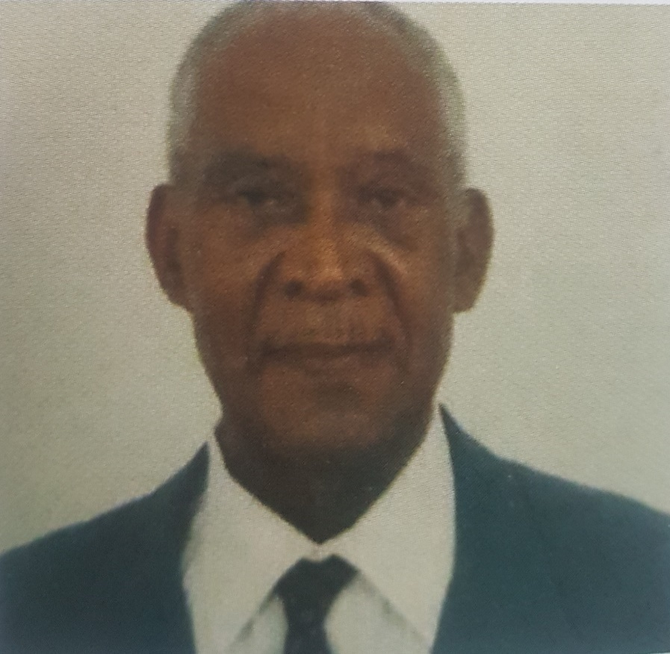
The Ronald and Jessica Bourne Award for Commitment and Service to the Optimist International Caribbean District
Incentive: Plaque
Eligibility:
Awarded to:
An active Optimist member who has demonstrated a consistently high standard of commitment, integrity and service to the District and who has had an unbroken membership of a minimum of 10 years.
The member and the member’s club(s) must be in good financial standing with Optimist International and the District.
How to apply:
Applications should be submitted to the Chair of the Past Governors Association by April 8 of each year.

Slide 22
Persistency Award
Incentive: Banner Patches
Eligibility:
Awarded to newly built clubs and sponsor clubs. The criteria shall be as follows:
Qualification for the award will be based on an assessment over 3 club years covering no less than 30 months
New Clubs should complete all requirements of the 90-Day Follow-Up Programme with no less than 30 Club Members on roster. (Incentives for these are already covered by Optimist International)
Beyond the Charter Banquet, both the Sponsor Club(s) and the New Club should achieve no less than Honour Club status for each full Club Year during the period of the assessment for the Persistency Award. (Already covered by OI)
Both Sponsors and New Clubs shall be represented at and participate in all Zone Meetings, District Conferences and Conventions, and all District Board Meetings

Slide 23
Persistency Award
Incentive: Banner Patches
Eligibility:
Awarded to newly built clubs and sponsor clubs.
The criteria shall be as follows:
New Clubs shall sponsor and have for a period of no less than 14 months, at least 1 JOI Club in good standing on register at the time of the assessment. (Covered OI)
The Sponsor Club(s) shall add at least 1 fully paid-up District Life Member for each year of the assessment for the Award. (Benefits as per District Life Member programme)
The New Club shall have at least 1 fully paid-up District Life Member over the full period of assessment for the Award. (Benefits as per District Life Member programme)
New Clubs are to achieve a minimum of 5 Members attaining Level 5 in the PGI/PDP programme.

Slide 24
The HYPEST Zone Award
Incentive: Monetary Donation to each Club in the Zone
Eligibility:
Awarded to the Zone that receives the highest score based on the following criteria:
A maximum of 10 points for best Social Media take over posts during the zone’s HYPE De Zone month
5 points for each new club built during the year
1 point for each net positive member the Zone has added during the year
5 points if the Zone executes a project during its “HYPE De Zone” month related to the District Flagship Project
5 points if the Zone is featured in the media during its “HYPE De Zone” month
7 points if the Zone hosts a fun social activity for members and prospective members during its “HYPE De Zone” month
7 points if the Zone hosts an event to honour its Unsung Members who have given stellar service to their Clubs and the Zone.

Slide 25
QUESTIONS

Slide 26
CONGRATULATIONS!

